Slide 1
SOLAR X-RAY BURST DETECTION
​

Slide 2
THE TEAM
Mentors - Hryadyansh Saraswat and Aridaman Singh Chauhan
Seniors - Pranav Iyengar and Gautam Dhulipala
Members - Pourush Sharma
Meghana Reddy
Vershita Yadav
Arnav Thakur

Slide 3

PROBLEM STATEMENT
(IT IS THE MID-PREP PROBLEM STATEMENT OF INTER-IIT TECH MEET 10.0)
Build a stand-alone web-based application using open-source software(s) to identify and categorize X-ray bursts. Given data will include long-duration X-ray light curves as well. Parameters like the rise and decay time, peak flux, duration of bursts, etc., must be derived. False detection should be minimum, and all bursts must be detected. The problem can be broadly categorized into two parts: 1. Developing a statistical/machine learning model to cover the mentioned parameters. 2. Deploying it efficiently to a stand-alone application and web-based tool (no additional APIs used). The web-based tool should visualize the light curve data, feature a GUI for light curve distribution visualization, analyze wavelets, display particular portions of distributions as time series: confirming burst occurrence, etc.

Slide 4
PLAN OF ACTION
DATA COLLECTION
DATA PREPROCESSING
FEATURE EXTRACTION
ML MODEL
WEB APPLICATION

Slide 5
INTRODUCTION
PRESENTATION TITLE
A solar X-ray burst, also known as a solar X-ray flare, is a sudden and intense release of energy in the form of X-rays from the Sun. These bursts are caused by the interaction of magnetic fields on the Sun's surface, which can result in the rapid release of magnetic energy and the acceleration of charged particles, primarily electrons. This process is often associated with sunspots, which are areas of intense magnetic activity on the Sun.
Our objective is to identify the solar X-ray bursts and a machine learning model is employed to classify the bursts.

Slide 6
DATA COLLECTION
PRESENTATION TITLE
Extracted the data recorded by the X-Ray Solar Monitor of Chandrayaan 2 from ISRO’s PRADAN website https://pradan.issdc.gov.in/
From each zip file we extracted .lc and .gti files and used astropy to read the files. We considered around 580 files.
.lc files provide the data of x-ray flux variation over time. We have four fields in each file - Time, Rate, Error, and Fracexp.
.gti files provide the time intervals during which the data is reliable and valid. We have the start time and stop time of that valid time interval.

Slide 7
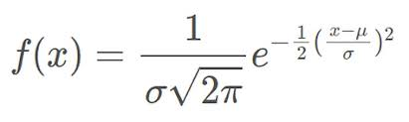
DATA PREPROCESSING
PRESENTATION TITLE
To obtain useful light curves we combined the .lc and .gti files.
We plotted a graph with the time of observations on the x-axis and flux rate on the y-axis.
To smoothen the curve and remove noise, we used the Gaussian method.
This method is useful for large datasets and gives higher weightage to central points.
By increasing the prominence value and determining the threshold value we extracted the distinct peaks.

Slide 8
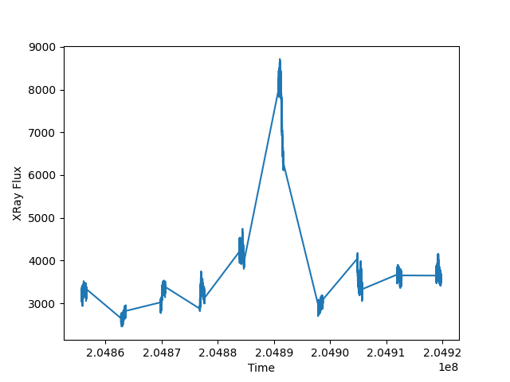
Lightcurve with noise
PRESENTATION TITLE

Slide 9
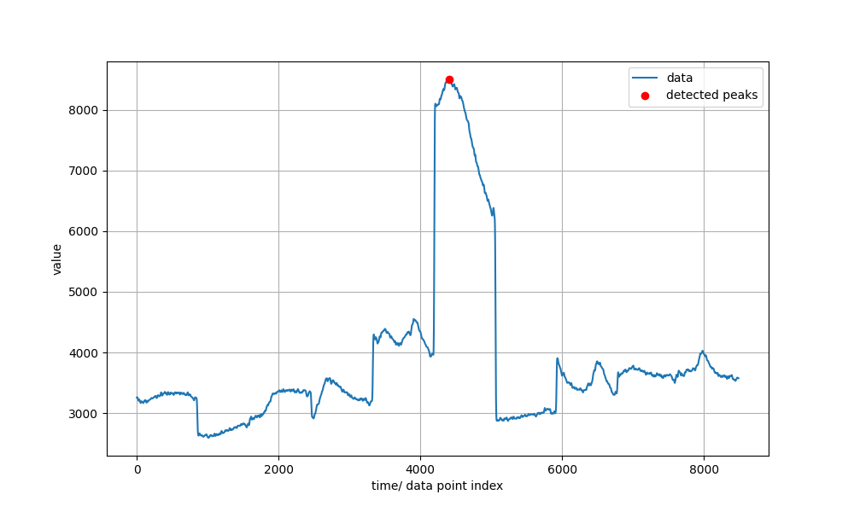
Lightcurve after smoothning and peak detection
PRESENTATION TITLE

Slide 10
FEATURE EXTRACTION
PRESENTATION TITLE
After running the previous code for all lc and gti files we extracted the following features and created a dataset.
Peak width – function from scipy.signal.
Start time and end time – left and right boundaries of peak width.
Maximum time – the time at which peak occurs.
Peak Rise time – time taken to rise from 10% to 90% of its maximum value.
Peak Fall time – time taken to fall from 90% to 10% of its maximum value.
Peak flux – maximum flux observed at the peak.

Slide 11
MACHINE LEARNING MODEL
PRESENTATION TITLE
K-Means Clustering Algorithm- It is used for grouping data points into clusters based on their similarity.
First we find the optimum number of clusters using the elbow curve method.
Centroid is a data point at the centre of a cluster. Each data point is assigned to its nearest centroid based on Euclidean distance.
Next we recalculate the centroids and repeat the steps until there are no changes in cluster assignments.
Now the algorithm has converged and each data point is assigned to one of the clusters.
With this we can classify the X-ray bursts and analyse their characteristics.

Slide 12
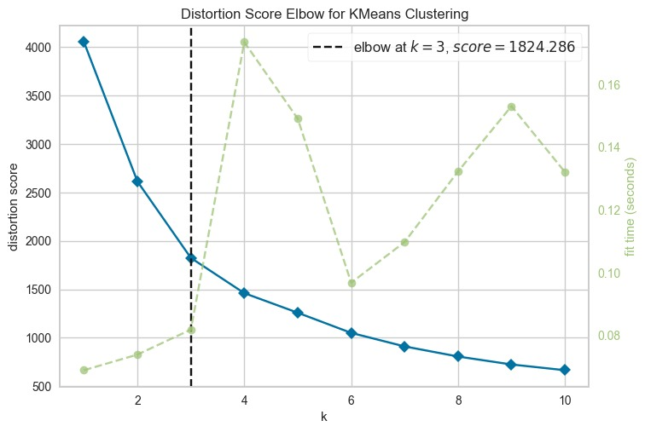
PRESENTATION TITLE

Slide 13
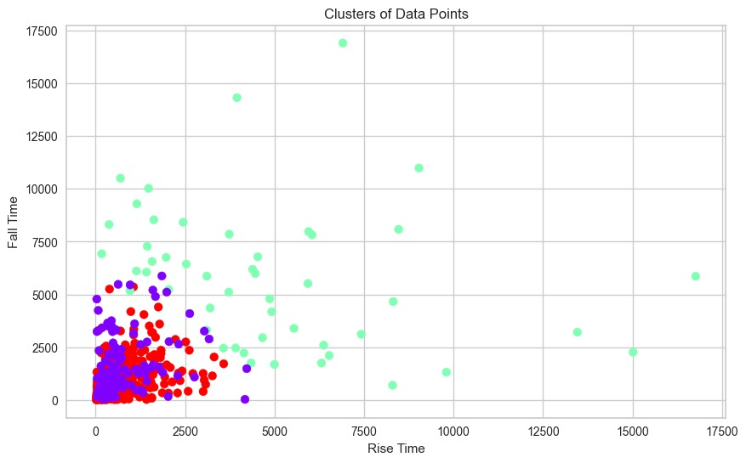
PRESENTATION TITLE

Slide 14
FUTURE DEVELOPEMENTS
PRESENTATION TITLE
Soon we aim to achieve the following-
Expanding the dataset to at least 900 files.
Making a web application.

